Slide 1
Ruby Training: More with Cucumber
Matthew Eakin, Manager
Managed Testing Practice
Sogeti, USA
Matthew.Eakin@us.sogeti.com

Slide 2
Agenda
The rake gem/tool
Rakefile.rb
Gemfile.rb
Running with rake
yml file
cucumber.yml
database_credentials.yml
Running Cucumber with rake
Tags
Rake namespaces
The features/support directory
env.rb
The BEFORE and AFTER blocks

Slide 3
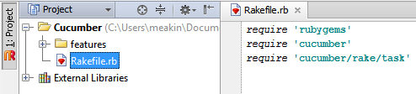
The RAKE gem/tool
The rake gem is a build tool for Ruby
Rake enables you to run Ruby projects with a TON of flexibility
Rake ensures everything is built properly
You have all the gems you say you need
There are no errors in the code
You start by creating a Rakefile.rb file in the root project directory
Add some gems:
require 'rubygems'
require 'cucumber'
require 'cucumber/rake/task'

Slide 4
Rake Tasks
Rake is driven by tasks
To define a task you use the “task” keyword
Syntax: You can also set any task as the default task:
task :<task name> do task :default => :<task name>
<code>
end
Add this task to your Rakefile.rb
task :say_hello do
puts “hello world”
end

Slide 5
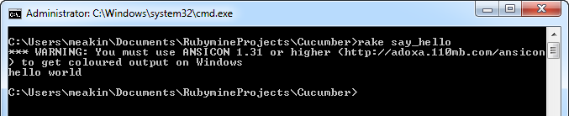
Running with Rake
Rake can be run from the Command Prompt
Navigate to the project root directory
Type: rake <task name>
Example:
Type “rake say_hello” at a command prompt in the Cucumber Project root directory
You should get this output:

Slide 6
Cucumber tasks in Rake
To run cucumber using rake you need a Cucumber task
Syntax:
Cucumber::Rake::Task.new(<cucumber task name>) do |t|
<code>
end
In your Rakefile.rb add the following cucumber task, but don’t run anything yet…
Cucumber::Rake::Task.new(:testing) do |t|
puts “I’m testing code”
end

Slide 7
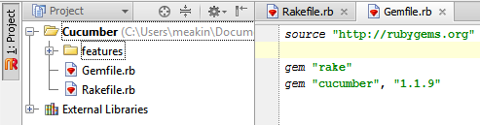
Gemfile
Used to tell the Ruby engine which gems to use for the execution of the project
Create “Gemfile.rb” in the project root directory
Add these 3 lines of code then re-run the rake command
source "http://rubygems.org"
gem "rake"
gem "cucumber", "1.1.9"

Slide 8
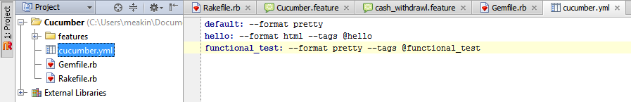
YAML files
YAML files are flat files used to store data in a structured formal
Must have the .yml extention
Can be one level deep or can be multiple levels deep
Create “cucumber.yml” in the project root directory
Add these 3 lines of code but don’t run anything, yet…
default: --format pretty
hello: --format html --tags @hello
functional_test: --format pretty --tags @functional_test

Slide 9
Using YAML files
To use a YAML file you use the YAML.load method
Syntax:
YAML.load_file(<file name>) or
YAML.load(File.open(<file name>)
The load function reads in the .yml file
Each line in a YAML file is treated as a Hash, with a key=>value pair. To reference a line you need to reference the Key
Syntax:
<file name>[<key>]
Add the following code to your Rakefile.rb, but don’t run anything yet…
Cucumber::Rake::Task.new(:functional_test) do |t|
cucumber_file = YAML.load(File.open("cucumber.yml"))
puts cucumber_file["functional_test“]
t.cucumber_opts = cucumber_file[" functional_test "]
end
Get the file
Pass “functional_test” parameters to cucumber

Slide 10
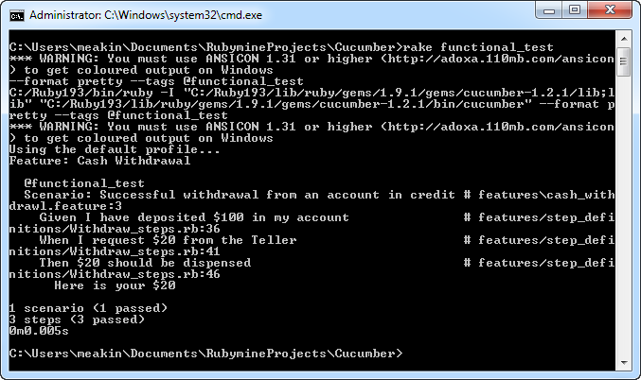
Running Cucumber with Rake
Rake will attempt to match-up the task names, regardless of whether it is a Rake task or a Cucumber task
At the command prompt type: rake functional_test
You should get the following:
puts “functional_test” parameters
“functional_test” parameters passed
Notes:
This is a trick exercise: no scripts should run because no scripts should have the @page-object-tests tags

Slide 11

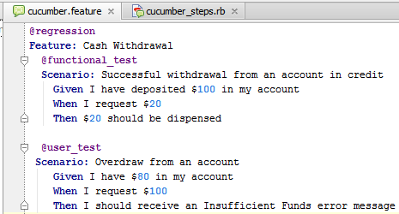
Tags
Tags are a powerful tool that enables you to run only specific files
They also make great documentation for your code
Tags can be added before the Feature line to run all Scenarios in the Feature
Or they can be added before each Scenario

Slide 12
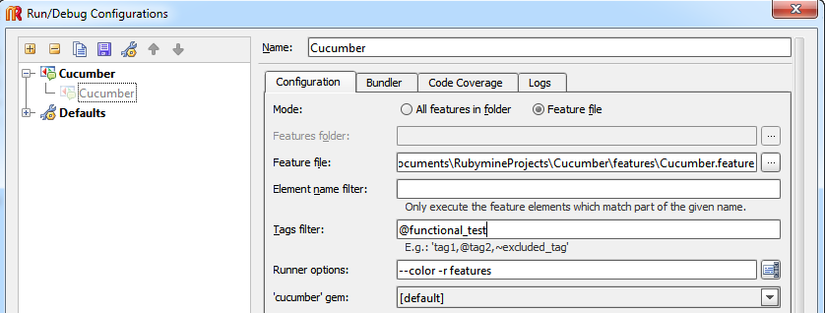
Setting-up tags
Goto Run -> Edit Configurations -> Cucumber -> <your project>
In the Tags filter tell it which tags you wish to run
Hit the “OK” button
Put tags here

Slide 13
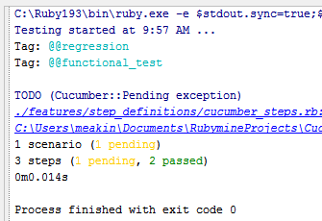
Running with tags
Go ahead and run the feature file by clicking the Green Arrow at the top
You should get the following Run message
Notice Ruby found all your tags
Notice Ruby only ran one Scenario

Slide 14
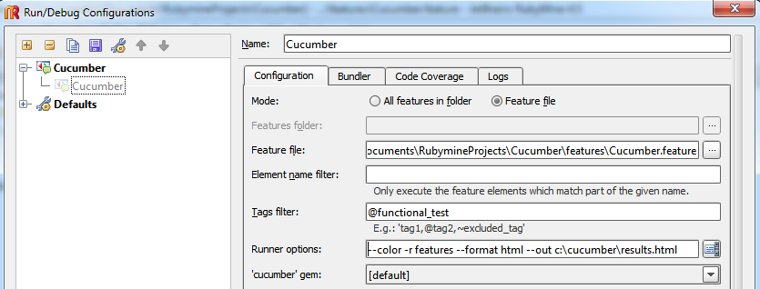
Proving you did something
One of the hardest things to do in automated testing is proving you did anything. We simply hit the “Run” button and if we get a green “all pass” then our tests all passed.
Goto Run -> Edit Configurations -> Cucumber -> <your project>
On the Configuration tab there is a section titled “Runner options:”
Change the line to the following:
--color -r features --format html --out c:\cucumber\results.html
Put formats here

Slide 15
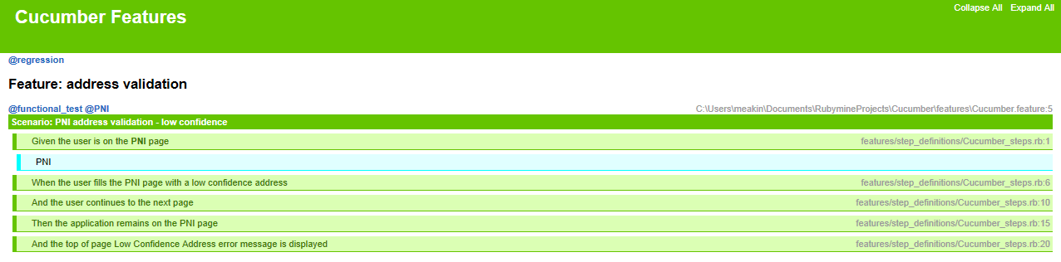
The Results of your Test
RUN THE .feature FILE!!!!
Open the c:\cucumber\results.html file and see what you have
Your Results are shown
Every Scenario and every Step run is listed
There are numerous other format options. The format gem is included in the standard Ruby build and is available in all projects. I would encourage you to read more on the topic as it can generate some very useful results reports

Slide 16
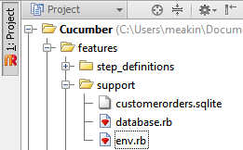
The features/support directory
The first directory ready by cucumber
Makes it a great place to:
Establish database connections
Set-up environment variables
Require any gems
Include other directories

Slide 17
The env.rb file
The very 1st file cucumber reads when executing
Where you set-up the environment
A great place to…
Require any gems
Require any files
Create a “support” Directory off the features directory
Create an “env.rb” file in the support Directory
Add the following lines to env.rb and re-run “rake functional_test”
require 'page-object'
require 'page-object/page_factory'
require 'active_record'
did you remember to add the gems to Gemfile?

Slide 18
The Before and After blocks
The “Before” block will happen before each Scenario is run
The “After” block will happen after each Scenario is run
Add the following code to your env.rb file and re-run “rake functional_test”
Before do |scenario|
puts "Starting scenario: #{scenario.name}"
end
After do |scenario|
puts "Ending scenario: #{scenario.name}"
end

Slide 19
Thank you

